Slide 1
ENG1003 Freshman Seminar for Engineering AAE Design of Path Planning Algorithm for Aircraft Operation Week 3: Introduction to GitHub Collaboration
Dr Li-Ta Hsu and Dr Weisong Wen
Assisted by
Man Hei CHENG (Melvin), Miss Hiu Yi HO (Queenie), Miss Yan Tung LEUNG (Nikki)

Slide 2
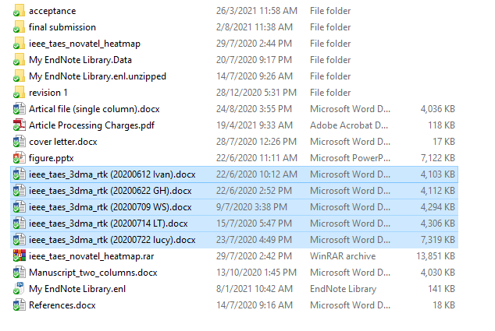
Mutual editing on a document with collaborators remotely?
Download files from various channels, such as mail, whatsapp, etc?
Can we edit the documents online ? Google, Microsoft has the solutions!
Can we edit the “code” online?
Github

Slide 3
Archive your coding online (in the cloud)
Video: VSC-Git Basic Opeartions
Pull: To clone everything in the cloud repository to the local repository
Pull (everything)
Clone/Fetch : To download a repository/branch to your local machine
Code and Debugger
Check out to: To edit the code from a certain branch
Cloud
repository (project)
Open file and Check out to
Clone/Fetch
Local
repository (project)
New
Version
Add
(Stage)
Commit
Push
Commit: To make a note for this version
Add (Stage): To combine the changes in the local repository
Push: To upload the code for this version to GitHub

Slide 4
Collaborative coding online – Generate Branch (Member)
Cloud
Repository
branch 1
To generate a branch for different member that participant the project.
Cloud
repository (project)
Cloud
repository
main (master)
To generate a branch for different member that participant the project.
Cloud
repository
branch 2

Slide 5
Collaborative coding online – Fetch/Pull Branch from Cloud
Cloud
Repository
branch 1
Fetch (Branch that you are interested)
Local
Repository
branch 1
Cloud
repository
main
Fetch (Branch that you are interested)
Local
repository
main
Cloud
repository (project)
Local 1
Repository (project)
Member 1
Cloud
repository
branch 2
Clone the repository from the cloud
Pull (everything)

Slide 6

Collaborative coding online – Edit the code in the local computer
Local
Repository
branch 1
Open file and Check out to
Check out to: To edit the code from a certain branch
Local
repository (project)
Member 1
Local
repository
main
Code and Debugger
Translating your math/physics knowledge into coding

Slide 7

Collaborative coding online – Edit the code in the local computer
Open file and Check out to
Local
Repository
branch 1
Code and Debugger
Local
repository (project)
Local
repository
main
Add
(Stage)
Finish a stage of your coding
New
Version
Commit
Give comments on your new version.

Slide 8


Concept of collaborative coding online
Video: VSC-Git Branches
Ready to update to the cloud branch!
Open file and Check out to
Cloud
Repository
branch 1
Local
Repository
branch 1
Code and Debugger
Push
Let the group leader knows my work
File 1 in the local
Merge by Pull Request
Add
(Stage)
Cloud
repository
main
File 1 in the cloud
New
Version
Commit
If the project leader does not know what you upload to the source code. Then you overlap the files! Lots of bugs!

Slide 9
Cloud
Repository
branch 1
Pull Request
Pull request: To apply for code review and potential version merge/combination
Group Leader can oversee the progress and control the master code!
Making decision to reject the pull request ask the member to revise.
Resolve Conflict
N
Existing Cloud
repository
main
Resolve Conflict: To review the conflict between the new version code with the existing code in main.
Y
Making decision to accept the pull request
Merged
(with Branch1) Cloud
repository
main
Merge
Merge: To merge the code from a newly developed version to the main version

Slide 10
Cloud
Repository
branch 2
Pull Request
Group Leader can oversee the progress and control the master code!
Merged
(with Branch1) Cloud
repository
main
Resolve Conflict
Resolve Conflict: To review the conflict between the new version code with the existing code in main.
More conflict!
After reviewing, making decision to change or reject the pull request.
Merged
(with Branch1 & Branch2) Cloud repository
main
Merge
Video: VSC-Git Conflicts

